Slide 1
Properties of Limits

Slide 2
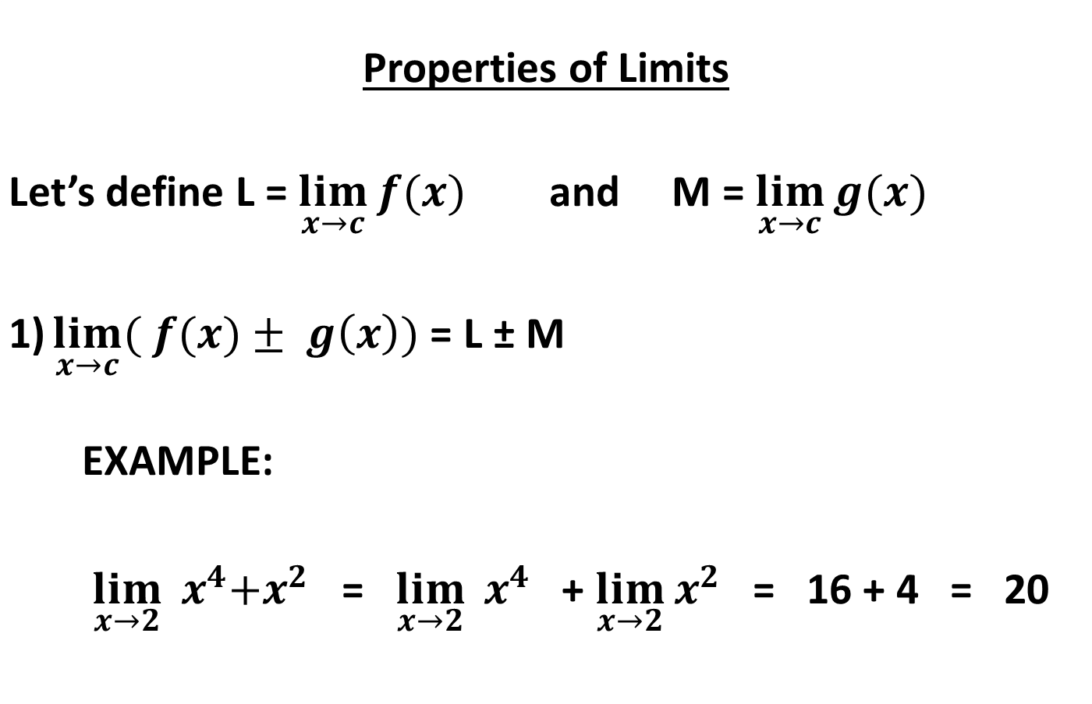
Properties of Limits Let’s define L = $\lim_{x→c}{f(x)}$ and M = $\lim_{x→c}{g(x)}$ $\lim_{x→c}{( f(x)}± g\left(x\right))$ = L ± M EXAMPLE: $\lim_{x→2}{{ x}^{4}+x^{2}}$ = $\lim_{x→2}{{ x}^{4}}$ + $\lim_{x→2}{x^{2}}$ = 16 + 4 = 20

Slide 3
Properties of Limits Let’s define L = $\lim_{x→c}{f(x)}$ and M = $\lim_{x→c}{g(x)}$ 2)$\lim_{x→c}{( f(x)}∗ g\left(x\right))$ = L * M 3)$\lim_{x→c}{k}∗ f\left(x\right))$ = k * L , where k = constant 4)$\lim_{x→c}{\frac{f(x)}{g(x)}}$ = $\frac{L}{M}$ when g(x) ≠ 0 and M≠ 0 5) And, for any function with an exponent, we can raise the Limit to the exponent, too: $\lim_{x→c}{{f(x)}^{\frac{r}{s}}}$ = $L^{\frac{r}{s}}$

Slide 4
Finding limits using substitution:
We can find the limits of a function in a variety of ways. When possible, it is easiest to use substitution. Then, verify graphically.
EX: Find $\lim_{x→2}{{ 9x}^{4}}$ = 9$\lim_{x→2}{{ x}^{4}}$ = 9(16) = 144
============================
EX: Find $\lim_{x→2}{{ x}^{4}+x^{2}−1}$ =
============================
EX: Find $\lim_{x→3}{x^{2}(2−x)}$ =
============================
EX: Find $\lim_{x→c}{{ x}^{3}+4x^{2}−3}$ =

Slide 5
Sometimes, we cannot substitute, for instance when the denominator would go to zero. Then, factoring is your next best friend…
EX: Find $\lim_{x→5}{\frac{x^{2}− 25}{x^{3}−125}}$ = $\frac{(x−5)(x+5)}{\left(x−5\right)( x^{2} + 5x + 25)}$ = $\frac{2}{15}$
EX: Find $\lim_{x→1}{\frac{ x^{2}− 1}{x − 1}}$

Slide 6
Finding limits using algebra
Sometimes, we can’t substitute directly, and can’t factor. You might have to use some more algebra…
EX: Find $\lim_{h→0}{\frac{16 ({2+h)}^{2}−16{\left(2\right)}^{2}}{h}}$
Why can’t we use direct substitution yet?
But if we use some algebra skills to simplify this equation, then we can use direct substitution.
Foil and distribute, then simplify… see what happens.

Slide 7

Use algebra to find this limit…
$$\lim_{x→0}{(\frac{\sqrt{x+4}−2}{x})}=$$

Slide 8
Indeterminate Limits
We can never divide by zero, or ‘do algebra’ with infinity.
Fractions like $\frac{0}{0}$ , $\frac{∞}{∞}$, and 0 • ∞ are called “indeterminate forms”.
You CANNOT use direct substitution for indeterminate limits.
Even if you think 0/0 = 0, or $\frac{∞}{∞}$ = 1, it probably doesn’t.

Slide 9
EX: Find $\lim_{x→0}{\frac{tan x}{x}}$
We could employ the same graphical method as we did with sinx/x (remember yesterday…).
But let’s practice using our Limit Properties. Remember that
tan x = $\frac{\sin{x}}{\cos{x}}$
so $\frac{tan x}{x}$ = $\frac{\sin{x}}{\cos{x}}$ $\frac{1}{x}$
This can be re-written $\frac{tan x}{x}$ = $\frac{\sin{x}}{x} \frac{1}{\cos{x}}$
Why is that useful???
$\lim_{x→0}{\frac{tan x}{x}}$ = 1
Verify this graphically!

Slide 10
Sandwich Theorem
We can sometimes find a limit indirectly using the Sandwich Theorem.
We can apply this theorem when a function, f(x) is always greater than a function, g(x), but less than a third function, h(x).
The poor function, f(x) is “sandwiched” between g and h.
If g(x) and h(x) both have the same limit as x→ c, then f(x) also must share that limit.

Slide 11
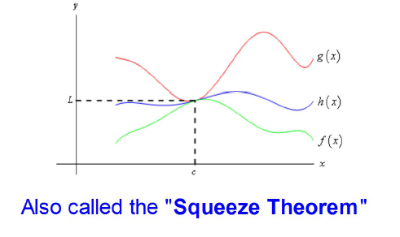
Sandwich Theorem: If g(x) ≤ f(x) ≤ h(x), for all x ≠ c in some interval about c, and $\lim_{x→c}{g(x)}$ = $\lim_{x→c}{h(x)}$ = L Then $\lim_{x→c}{f(x)}$ = L.

Slide 12
Using the Sandwich Theorem
Show that $\lim_{x→0}{x^{2} sin{\frac{1}{x}}}$ = 0.
Solution: We know the range of the sine function is [-1,1].
It follows that the range of sin $\frac{1}{x}$ is also [-1,1].
We can write -1 ≤ sin(1/x) ≤ 1
Since x² is always positive, we can multiply through without changing the inequality.

Slide 13
Using the Sandwich Theorem
Show that $\lim_{x→0}{x^{2} sin{\frac{1}{x}}}$ = 0.
We can write -1x² ≤ x²sin(1/x) ≤ 1x²
Our function is sandwiched between ±x²
The $\lim_{x→0}{x^{2}}$ = 0.
The $\lim_{x→0}{{−x}^{2}}$ = 0.
Therefore, $\lim_{x→0}{x^{2} sin{\frac{1}{x}} }$ = 0.

Slide 14
Summary – Ways to find a limit
Substitution
Graphically
Numerically
Using algebra
Sandwich Theorem

Slide 15
Assignment
P. 62 #7-11, 22-30even, 41-43, 45, 46, 54-57

